Slide 1
CS4182 Computer Graphics Project
Member: Fung King Shun (56659723)

Slide 2
Game Guideline
AIM: “Using the least time to get most of stars and finish the game”
Game Control:
Changing game screen size
Moving the jeep using keyboard
Changing different setting using menu and mouse

Slide 3

Requirements
Basic Requirements
Creating new objects
Menu and Lighting
Manipulation
Adding autonomous objects
Window resolution
Accelerating ribbon
Advanced Requirements
Scouring system
Ranking system
All of the basic and advanced requirements are completed!

Slide 4
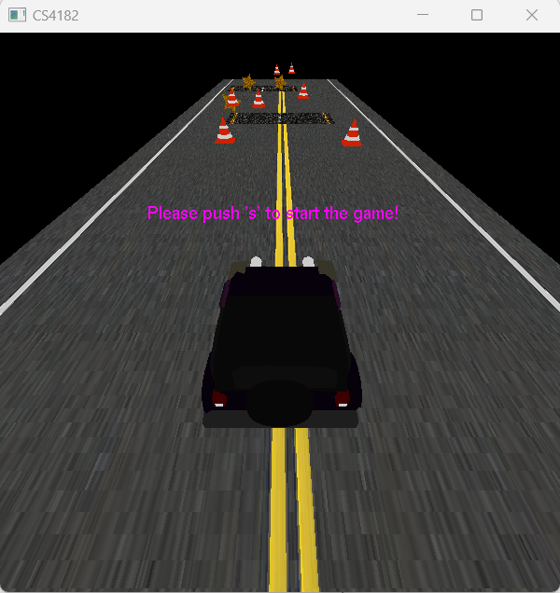
1. Creating new objects
Objects:
5 star
4 accelerating ribbon
Creation:
Textures loaded
Star placed at random
Star object don’t overlap with cone

Slide 5
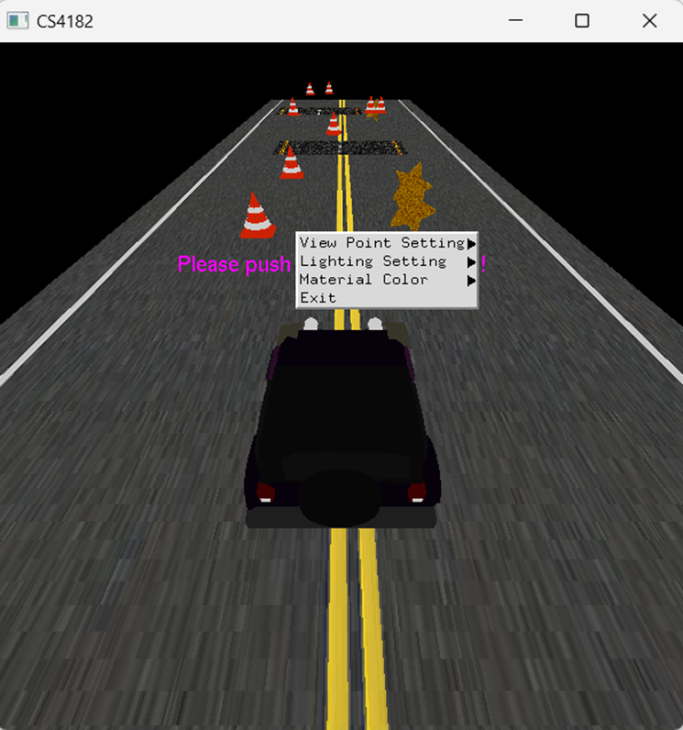
2. Menu and Lighting
Menu Part
Top menu + Sub menu
Operation:
(Mouse Right Click )
3 Sub menu function
View point setting
Lighting setting
Material color
1 Top menu function
Exit

Slide 6
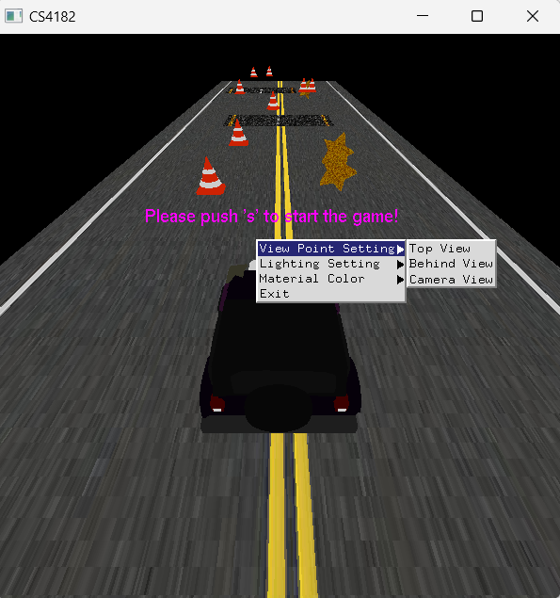
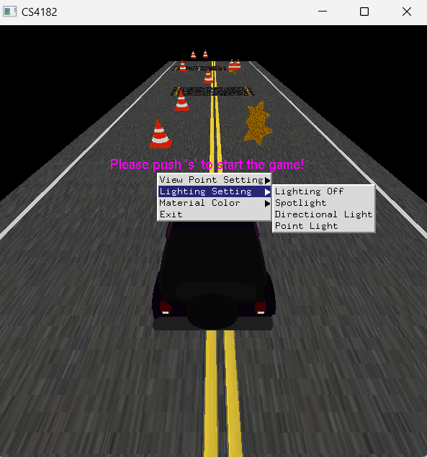
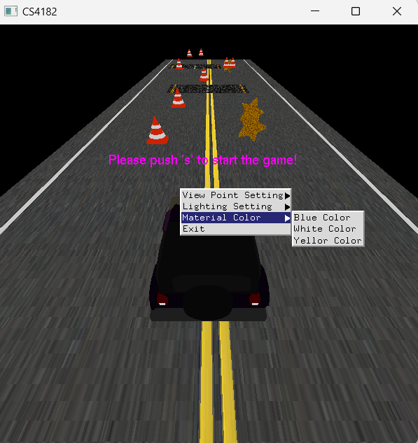
2.1. Sub Menu

Slide 7
2. Menu and Lighting
Lighting Part
Operation:
(Change different light setting at menu)
Lighting:
No lighting (Default)
Spotlight
Directional light
Point light

Slide 8
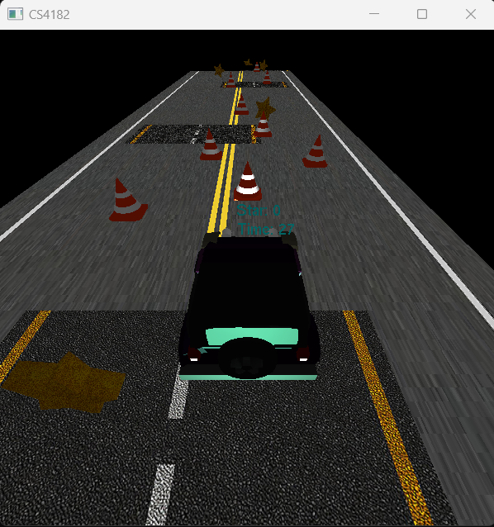
2.1. Spotlight
Condition:
Only lighting within the angle object
Spotlight location follow the jeep

Slide 9
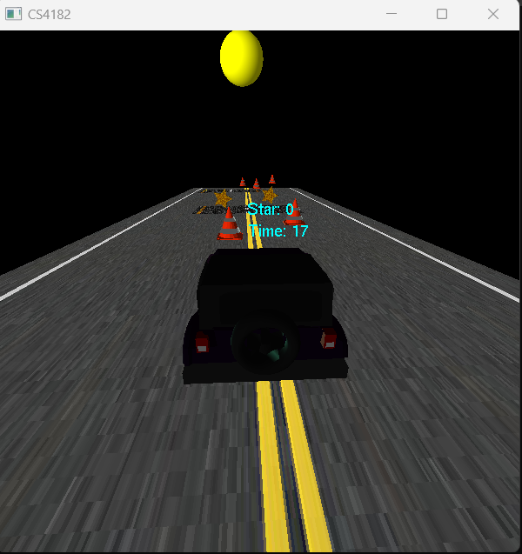
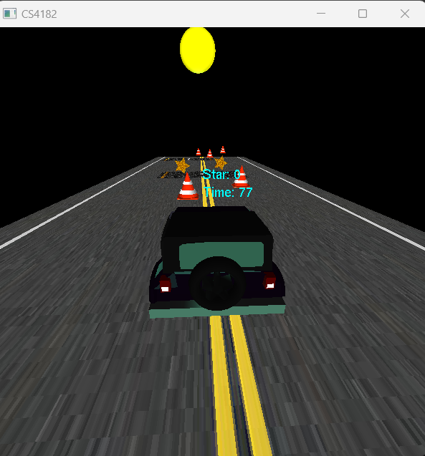
2.2. Directional light
Condition:
Lighting only come from one direction
front direction
back direction

Slide 10
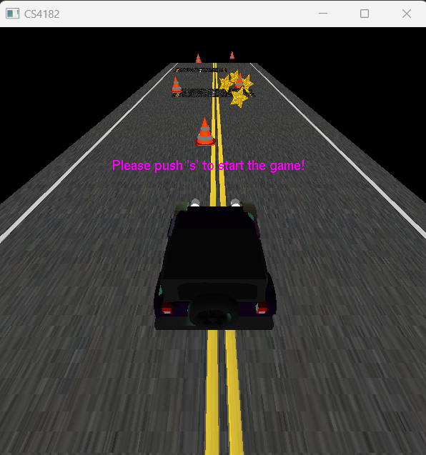
2.3. Point light
Condition:
Lighting come from any direction
front direction and back direction

Slide 11
2.4. Material Color
Use different combinations of ambient, diffuse, specular
Operation:
(Change different material color setting at menu)
Lighting:
White (Default)
Blue
Yellow
Condition:
Only runnable if the lighting setting not in ‘No lighting’ mode

Slide 12
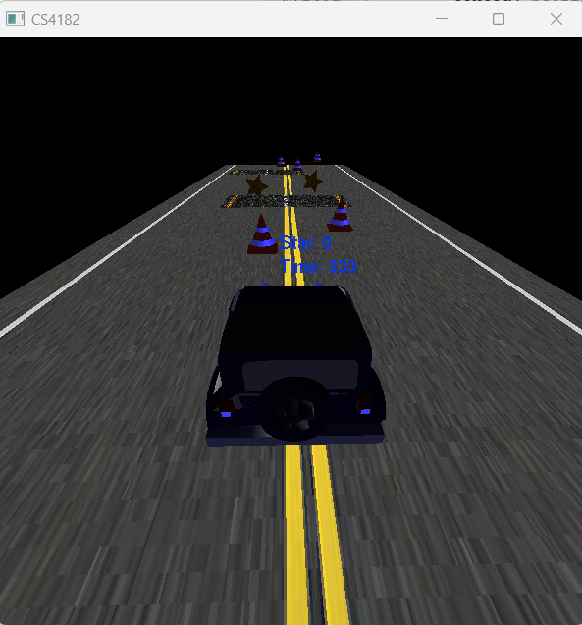
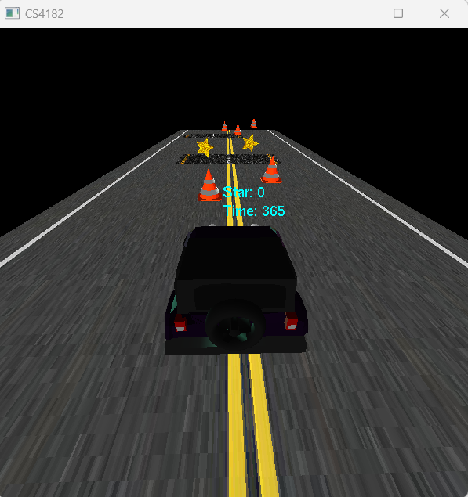
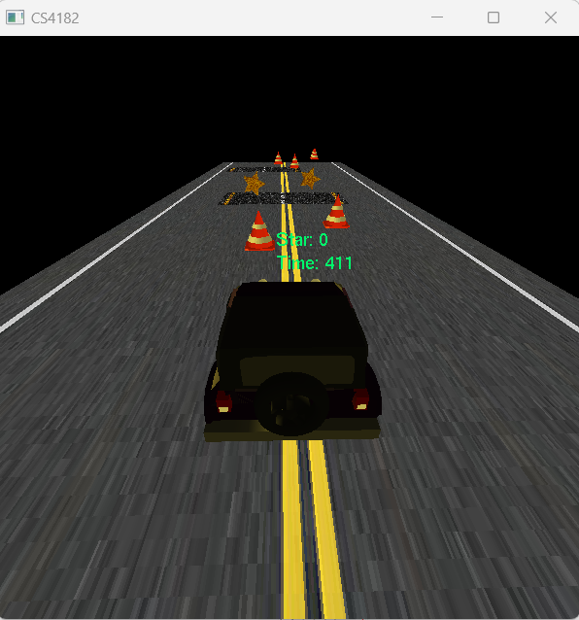
2.4. Material Color
blue
white
yellow

Slide 13
3. Manipulation
Operation:
Change different view point setting at menu
Using mouse scroll to zoom in or zoom out
Using keyboard to move the jeep
View point:
Camera view (Default)
Behind view
Top view

Slide 14
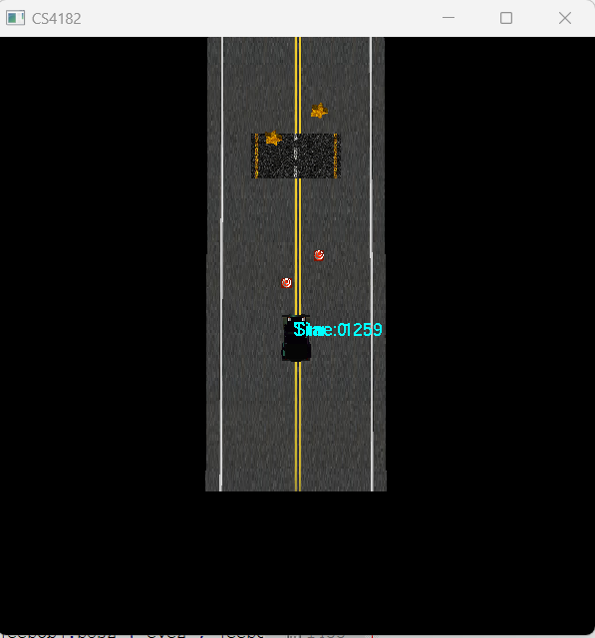
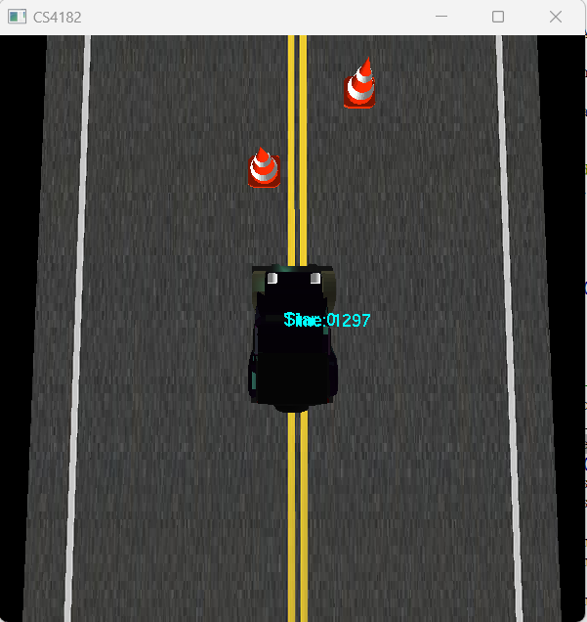
3.1. View Point (1)
Top view
Top view with zoom in

Slide 15
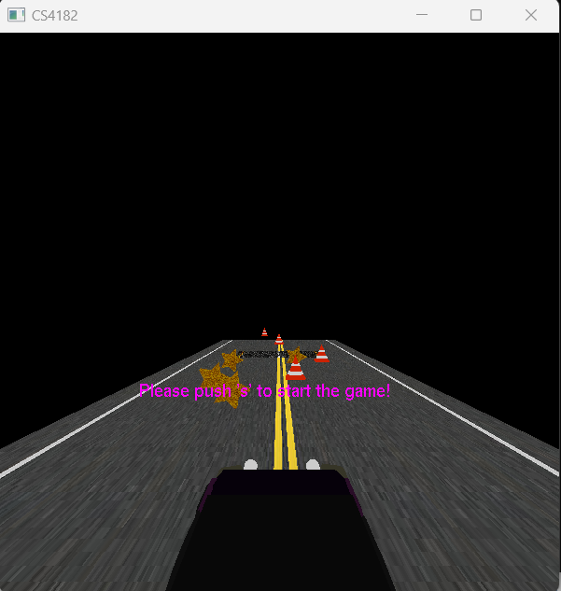
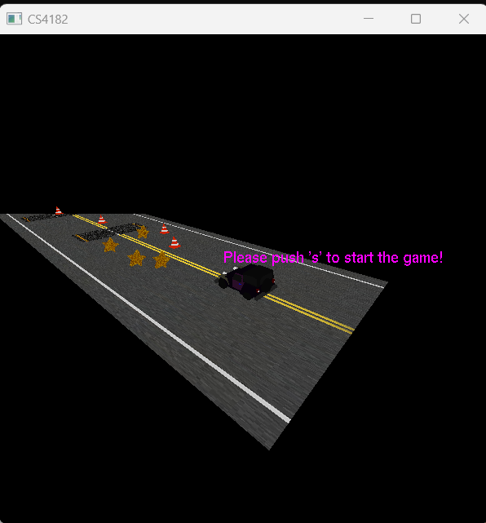
3.1. View Point (2)
behind view
Camera view with zoom out

Slide 16
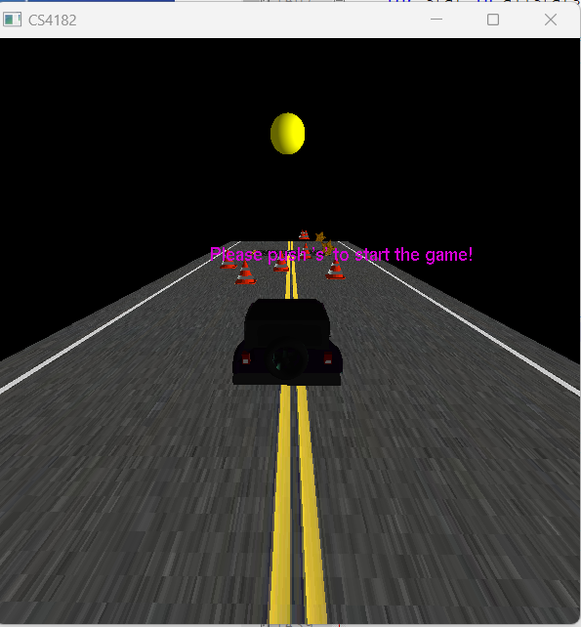
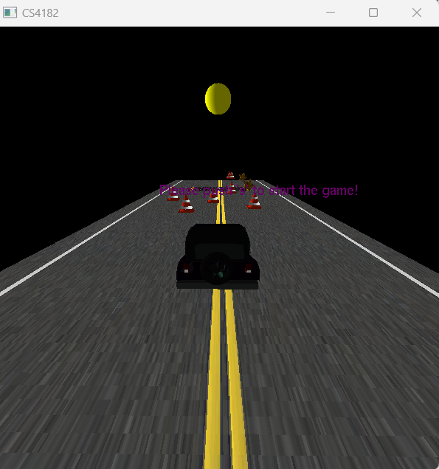
4. Adding autonomous objects
Operation:
Select directional light in menu
Creation:
Sun object
self-rotates by the y-axis
Affect the
environment of the
lighting

Slide 17
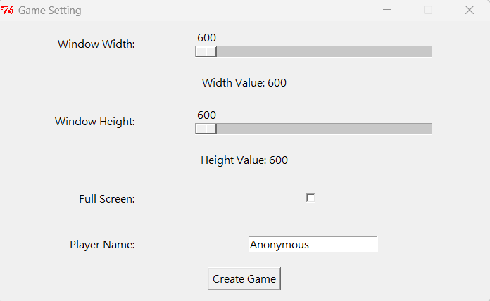
5. Window resolution
Operation:
When the program executed
Creation:
Extra python UI library (tkinter)
Pop-up box

Slide 18
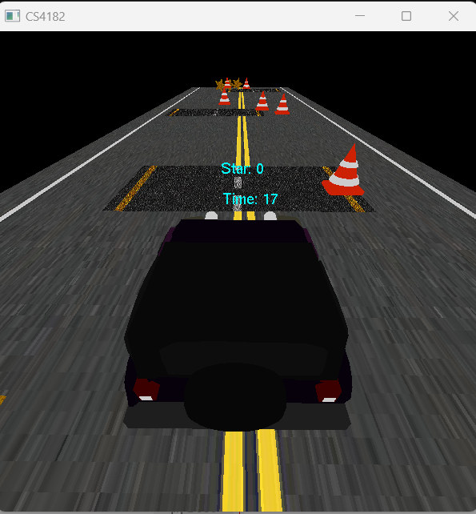
6. Accelerating Ribbon
Operation:
When the jeep passing accelerating ribbon
Jeep speed +0.2
Creation:
Fixed location

Slide 19
Advanced Requirements
Scouring System
Record current game get how many stars and time

Slide 20
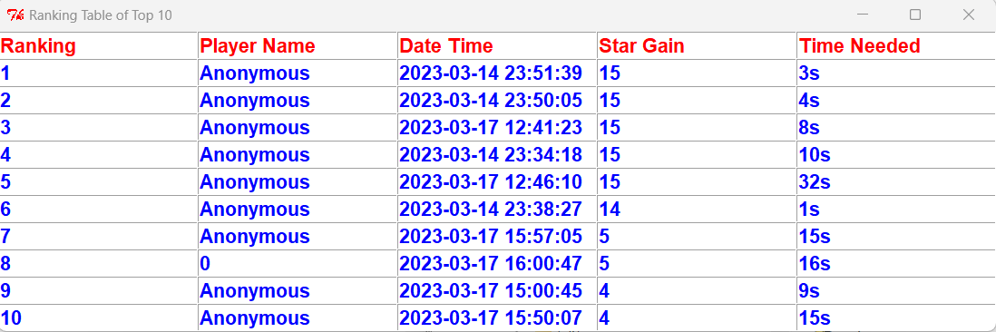
Advanced Requirements
Ranking System
Sorting and display the top 10 result table
Data saved in a excel file:
using python code to load and update the data
Algorithm:
first to sort star gain, then sort the time needed

